Slide 1

CAPSTONE PROJECT PROJECT TITLE
Voice-Activated Virtual Assistant using NLP and Transformers
Presented By
Student Name:Raavi Ramya Sree
College Name:Nri Institute of technology
Department:computer science and engineering
Email ID:raaviramya46@gmail.com
AICTE Student ID:STU67614715f3d081734428437

Slide 2
OUTLINE
Problem Statement (Should not include solution)
Proposed System/Solution
System Development Approach (Technology Used)
Algorithm & Deployment
Result (Output Image)
Conclusion
Future Scope
References

Slide 3
Problem Statement
In today's digital world, voice-activated virtual assistants are becoming increasingly important to simplify daily tasks such as retrieving information, answering queries, simplifying text, and providing assistance. However, existing commercial solutions like Siri, Alexa, and Google Assistant present several limitations:
Require continuous internet access and cloud dependency.
High development and maintenance costs for custom applications.
Limited flexibility for academic, educational, or small-scale personal projects.
Many students, researchers, and small developers need a lightweight, offline-capable, customizable voice assistant that:
Can function without expensive cloud services.
Uses pre-trained open-source AI models.
Potential data privacy and security concerns due to third-party cloud usage.
Runs efficiently on local machines or simple platforms like Google Colab.
Performs natural language processing tasks such as text simplification, intent detection, and basic voice interaction.
This project aims to address these challenges by developing a Voice-Activated Virtual Assistant using open-source NLP models (T5-small) and speech synthesis (gTTS), requiring minimal hardware and fully operable offline after initial setup.
Cloud-based solutions like Siri, Alexa, or Azure require internet access, subscriptions, and heavy cloud dependencies. The goal is to create a lightweight, offline-capable voice assistant that works fully on local machine with basic NLP capabilities
There is a growing need for a cost-effective, fully customizable, and offline-capable voice assistant that can:
Operate on personal machines, laptops, or cloud notebooks like Google Colab.
Avoid cloud lock-in while still utilizing AI capabilities.
Perform basic natural language understanding (NLU) and task execution.
Simplify complex sentences using AI-based NLP models.
Convert text to speech to create a natural user interaction experience.

Slide 4
Proposed Solution
The proposed system is a lightweight voice assistant built using Python libraries (gTTS, transformers) and pre-trained NLP models (T5-small) that can work fully offline. It performs basic intent detection, responds with speech, and simplifies sentences using T5
Key Components
Input Interface (Simulated Speech Recognition):
For simplicity, user voice input is simulated through text input in Google Colab or local systems.
In future versions, speech input can be integrated using open-source libraries such as speech_recognition and pyaudio.
Natural Language Processing (NLP) & Intent Detection:
Rule-based keyword matching is used to detect user intent for basic queries such as:
Retrieving time and date.
Telling jokes.
Simplifying text.
Providing predefined responses.
Complex sentence simplification is handled using the T5-small Transformer Model from Hugging Face.
Response Generation:
For commands recognized by the rule-based system, predefined responses are generated.
For text simplification requests, the assistant simplifies complex sentences using the AI model.
Speech Synthesis (Text-to-Speech):
The generated response text is converted into speech output using Google Text-to-Speech (gTTS).
Audio responses are played directly within the Colab interface using IPython.display.
Offline Deployment:
Once the models are downloaded, the system operates offline.
Requires minimal computational resources.
No dependency on Azure, Google Assistant, or any third-party cloud platforms during normal operation.

Slide 5
System Approach
The System Development Approach outlines the strategy, tools, and technologies used to design and implement the Voice-Activated Virtual Assistant.
System Requirements
Hardware Requirements:
Personal Computer, Laptop, or Google Colab (no dedicated hardware required)
Speakers (for audio playback)
Internet (only for initial model download)
Software Requirements:
Python 3.x
Google Colab or Jupyter Notebook
Internet connection (only during model installation phase)
Libraries Used
transformers — Hugging Face T5-small model (for text simplification)
torch — (required backend for transformer models)
gTTS — Google Text-to-Speech (for speech synthesis)
IPython.display — For audio playback in Colab
datetime — To fetch system date and time
os — File handling (for conversation log)
T5-small (Pre-trained Transformer Model) from Hugging Face
gtts (for text-to-speech)
datetime, IPython.display, os (standard libraries)

Slide 6
Algorithm & Deployment
Algorithm Selection
The system uses a hybrid rule-based approach combined with pre-trained AI models for natural language processing.
Rule-based logic is chosen for intent detection as it is simple, efficient, and sufficient for handling basic voice commands such as time, date, jokes, and basic Q&A.
The T5-small transformer model (pre-trained on large text corpora) is used for text simplification, allowing the assistant to process and simplify complex sentences into easier versions.
Data Input
User Input: Text commands entered by the user (simulating voice input).
Pre-trained NLP Model: The T5-small model downloaded from Hugging Face is used as the language model.
No additional data collection or training is required since pre-trained models are directly utilized.
Processing Logic
The system first applies keyword-based intent detection on the input text.
If the input includes the "simplify" keyword, the sentence is passed to the T5-small model.
For recognized intents (time, date, jokes, identity, etc.), predefined responses are generated.
If the input is not recognized, a fallback response suggests example commands.
Deployment
The assistant is deployed fully offline after initial model download.
Implemented and executed in Google Colab or local Python environments.
No cloud services or real-time model training required.
Lightweight and easy to run even on low-spec hardware.
Response Generation & Speech Output
The generated response is converted into speech using the Google Text-to-Speech (gTTS) library.
The generated audio response is automatically played back inside Google Colab using IPython audio playback functionality.

Slide 7
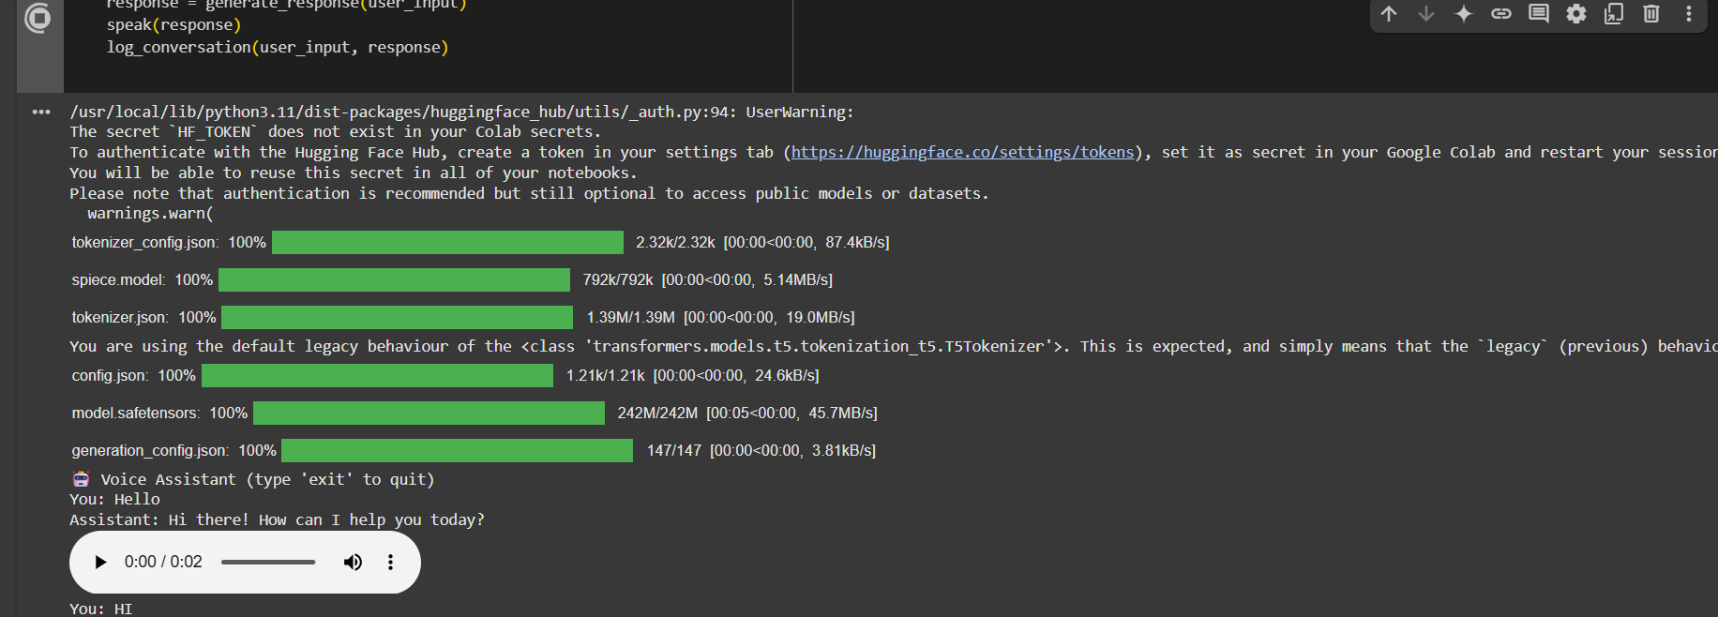
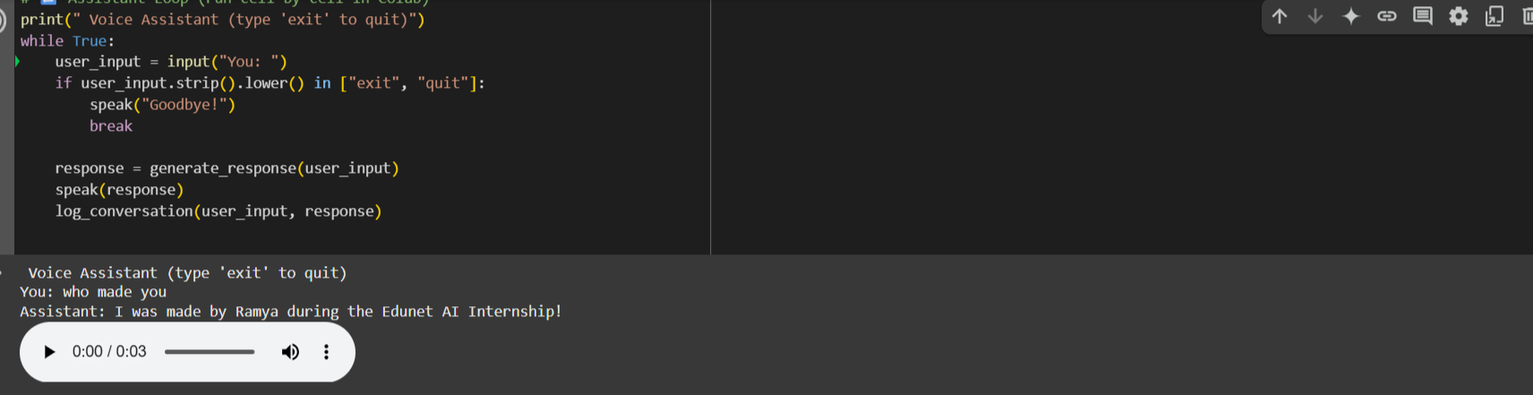
Result

Slide 8
Conclusion
The implemented Voice-Activated Virtual Assistant successfully demonstrates:
The ability to build functional AI-powered assistants using open-source NLP models and Python libraries, fully eliminating reliance on cloud services.
Real-time, text-based interaction combined with speech synthesis using Google Text-to-Speech (gTTS).
Sentence simplification achieved through pre-trained T5 transformer models from Hugging Face.
A lightweight, platform-independent solution that operates efficiently on personal computers and can be easily deployed on Google Colab or local environments.
The feasibility of developing intelligent assistants without requiring extensive in-house machine learning expertise or paid cloud platforms.
A flexible and extensible framework applicable to:
Academic learning assistants
Offline personal assistants
Educational tools for NLP demonstrations
Accessibility tools for differently-abled users
The project highlights how modern AI solutions can be made cost-effective, privacy-focused, and highly accessible for students, researchers, and small developers through the use of open-source tools and pre-trained models.

Slide 9
Future scope
While the current implementation demonstrates a functional offline prototype, several potential improvements can enhance the system:
Advanced Natural Language Understanding (NLU):
Replace rule-based intent detection with open-source models (spaCy, Rasa).
Add multi-turn conversation support with local context management.
Generative AI Integration (Optional Cloud Upgrade):
Optionally integrate OpenAI GPT-4 / GPT-3.5 APIs for dynamic conversational responses (requires cloud API access in future versions).Enable natural, contextual, and conversational interactions.
Voice Input Support:
Incorporate real-time speech input using speech_recognition and pyaudio libraries.
Enable fully voice-operated interaction in addition to text input.
IoT and Smart Home Integration:
Extend functionality to control smart devices via local IoT protocols (MQTT, Home Assistant).
Allow basic home automation without requiring cloud IoT hubs.
Security and Personalization:
Implement user profiles and customized responses.
Add basic voice authentication for secure usage.
Deployment Optimization:
Create a desktop application or lightweight mobile app for wider accessibility.
Package model downloads for fully offline first-time setup.
Real-Time Speech Input
Incorporate real-time speech input using speech_recognition and pyaudio to enable full voice-based interaction, removing the need for simulated text input.

Slide 10
References
Google Text-to-Speech (gTTS) Documentation Python package for speech synthesis https://pypi.org/project/gTTS/
Hugging Face Transformers Library Open-source library for natural language processing https://huggingface.co/docs/transformers/index
T5: Exploring the Limits of Transfer Learning with a Unified Text-to-Text Transformer https://arxiv.org/abs/1910.10683
Python Official Documentation Core language documentation https://docs.python.org/3/
IPython Display for Audio Playback https://ipython.readthedocs.io/en/stable/api/generated/IPython.display.html
spaCy Documentation (For NLU - Future Scope) https://spacy.io/
Rasa Open Source (For Dialogue Management - Future Scope) https://rasa.com/docs/
OpenAI API Documentation (Optional Extension - Future Scope) https://platform.openai.com/docs/

Slide 11
Thank you

